Slide 1
Mock Stock
Week 5
Theodore Hecht III, Luke Orr,
Jonathan Langston, Sebastian Schwagerl

Slide 2
Subsystem Identification
Front End:
Portfolio Screen (Trey)
Leagues Screen (Trey)
Marketplace Screen (Luke)
Detailed Stock Screen (Luke)
Back End:
Authentication Middleware (Sebastian)
Database Layer (Sebastian)
API Routes (Tyler)
3rd party API Layer (Tyler)

Slide 3
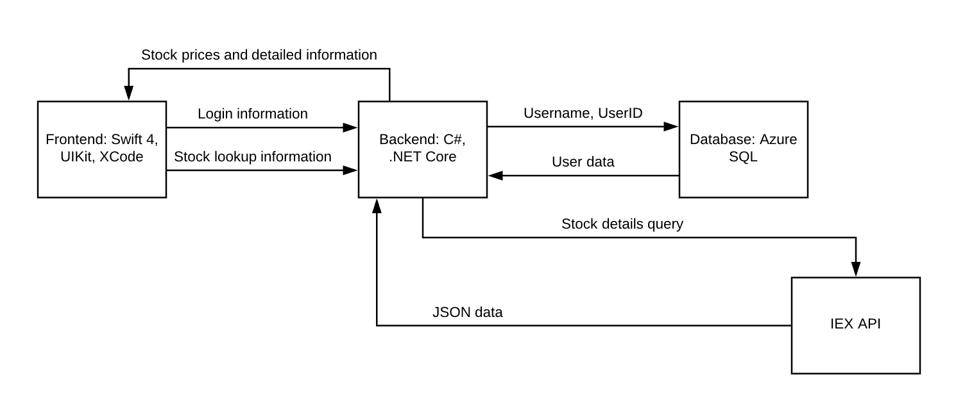
Overall System Operation

Slide 4
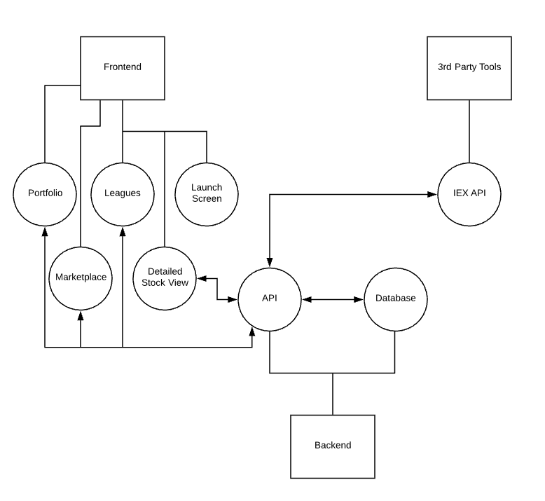
Sub-System Communication
The frontend will communicate with our API in the backend to request information that it needs. That API will then either communicate with the Database or any 3rd party tools like the IEX API depending on what information it needs to display to the user.

Slide 5
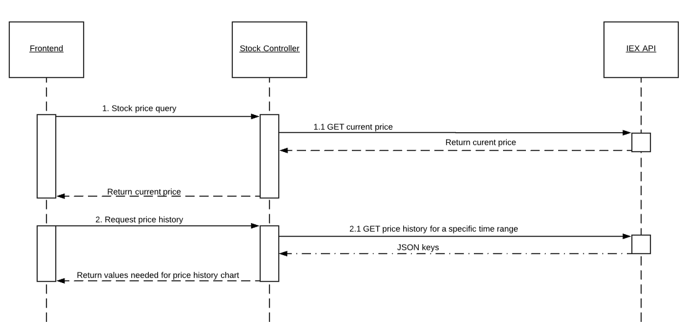
Backend - 3rd Party API Layer

Slide 6
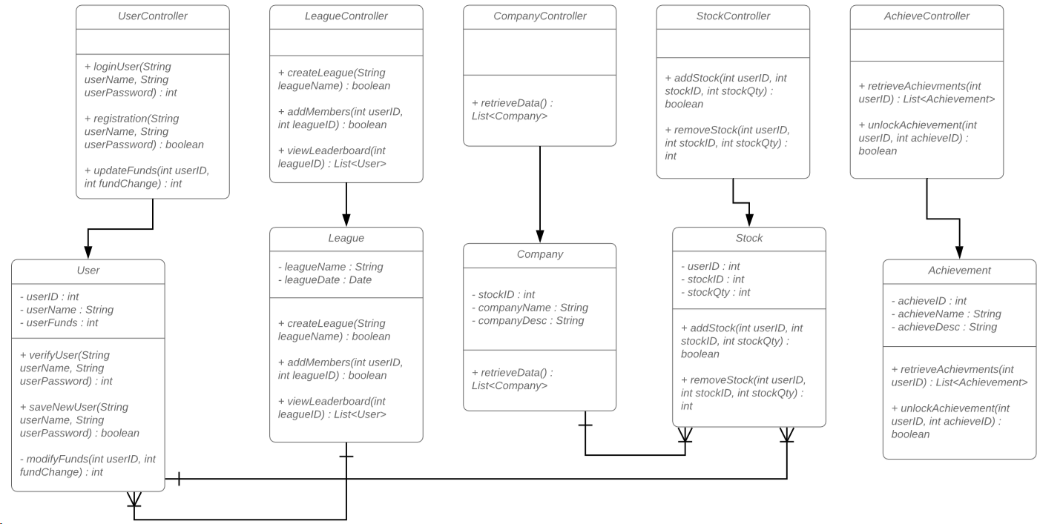
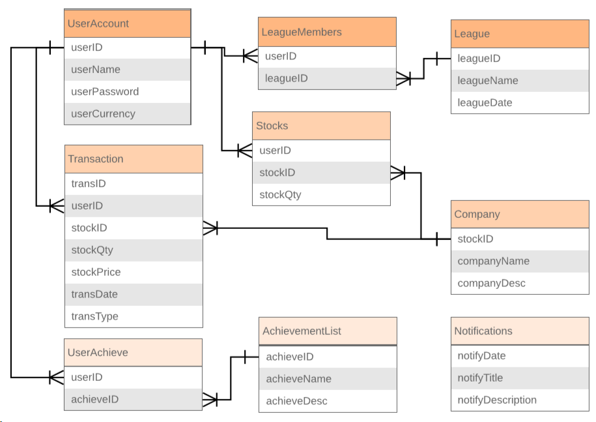
Database Layer
ER Diagram
UML Diagram

Slide 7
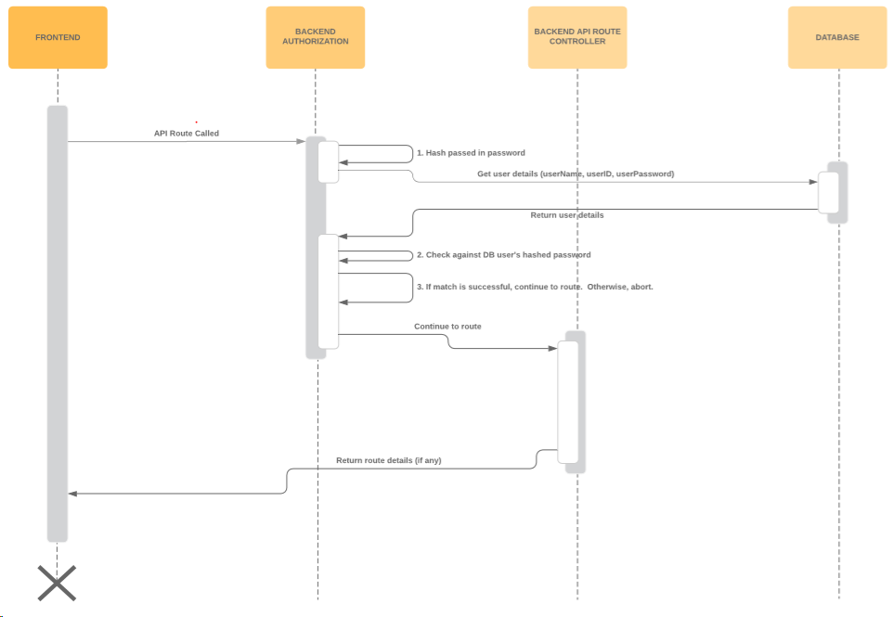
Authentication Middleware
This is the Sequence Diagram for how user authentication will be handled before reaching the Backend controllers.

Slide 8
Backend Analysis
Language: C# chosen due to developer familiarity.
Framework: .NET Core chosen because it can run on MacOS and Windows, unlike earlier versions of ASP.NET, which are windows only. This is important for our frontend team, which are developing for iPhone using MacOS.
Hosting: Azure. Integrates well with the C#/.NET stack. App Service offers free hosting for apps with horizontal scalability (increase # of instances of the app.) It also has several free database offerings, including credits for free use of PostgreSQL for a month, or free Azure SQL for a year.

Slide 9
Algorithm Analysis
Searching for stocks in a list.
Iterate through the whole list in the worst case. O(n).
Sorting stocks.
Merge Sort has a worst case complexity of O(n*log(n)).

Slide 10
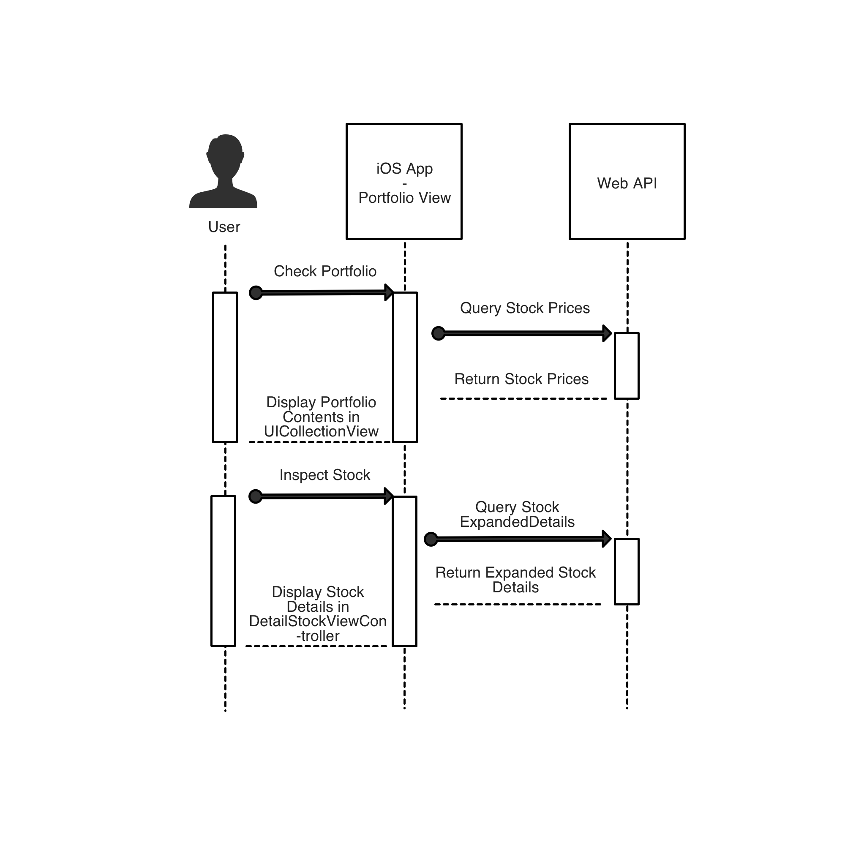
Portfolio Screen
This screen shows the user’s portfolio. It contains a list of stocks the user owns, along with their current prices and the entire portfolio worth. It gets the current details for the portfolio from the backend API. The user can click a specific stock to see its expanded details (price history, etc.)

Slide 11
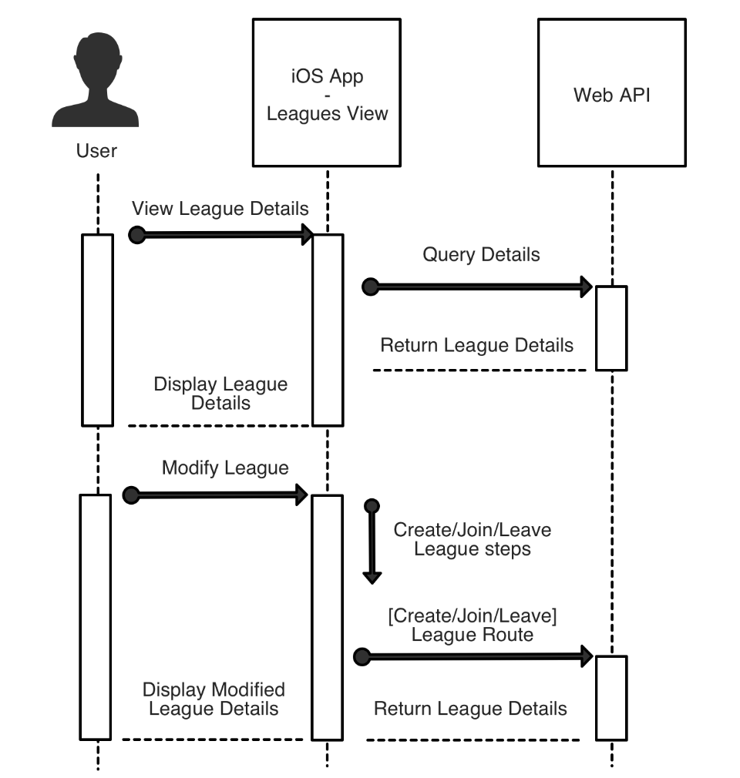
Leagues Screen
This screen shows all the leagues a user is a member of. A league is a competitive leaderboard with one or more users. Users can click on a league to see the current league details (a list of league members and their portfolio values.) Users can create, join, or leave leagues from this screen.

Slide 12
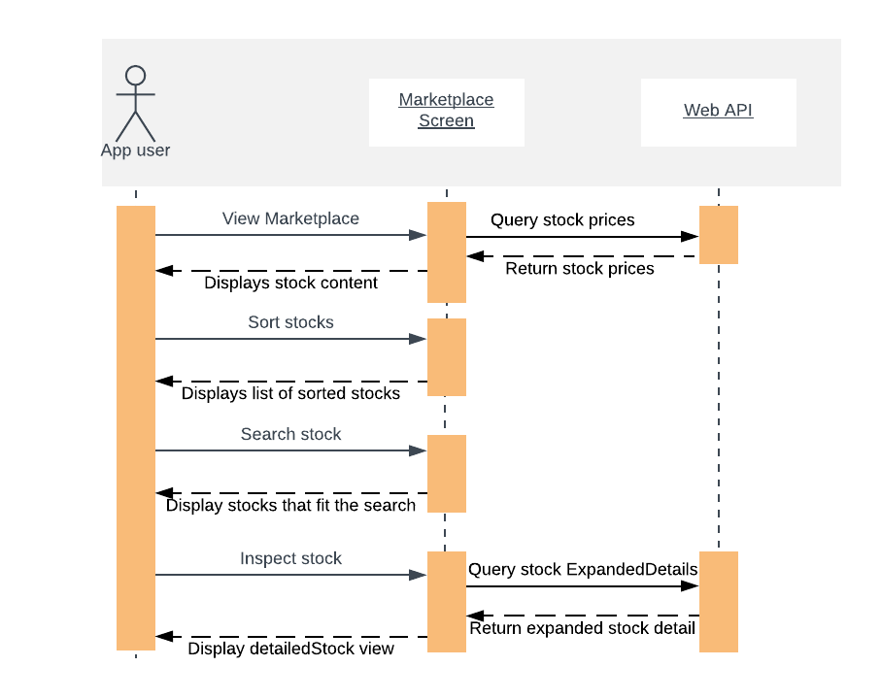
Marketplace screen
This screen shows the stock marketplace. It contains a list of sorted stocks based on the users sort selection. The user will also be able to search for stocks based off company name or ticker symbol. Current stock information will be obtained via the IEX api. The user can click a specific stock to see its expanded details (price history, etc.).

Slide 13
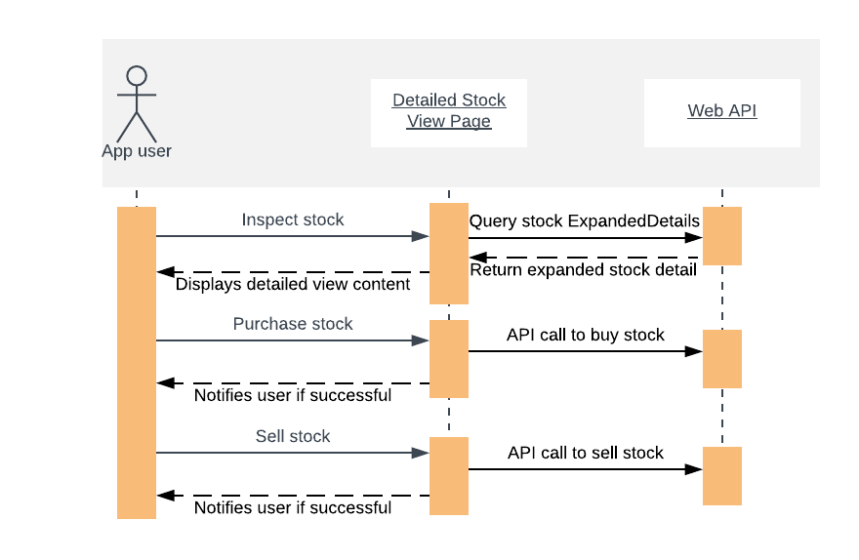
Detailed View Screen
This screen shows the detailed view of a specific stock. The screen will display stock details such as price, today's change, change in the past year, as well as a graphical representation of the stocks price fluctuation. From this screen users will also be able to buy and sell stocks.

Slide 14
Front End Analysis
Language: Swift 4 chosen due to developer familiarity, as well as less development complexity compared to Android. We looked at using flutter which is google's mobile app SDK that can be used to make apps for both android and IOS. We decided against using flutter since it is newer and none of us have any experience in using it.
Framework: UIKit chosen due to it providing the view architectures needed for our various frontend screens, such as the UICollectionView and UIStackView.

